Slide 1


DAY 4 - DYNAMIC FRONTEND COMPONENTS - SHOP.CO

Slide 2



OVERVIEW:
On Day 4, I implemented key features to enhance the functionality of my e-commerce website, Shop.co, ensuring a dynamic and user-friendly experience. Below are the details of the work completed:

Slide 3

FEATURES IMPLEMENTED
Product Listing Page:
Product Detail Page:
Add to Cart Functionality with Redux: Pagination with ShadCN UI:
Responsive Design with Tailwind css

Slide 4


TECHNICAL WORKFLOW
Product Listing Page Workflow
Fetched dynamic data from Sanity CMS to populate the product grid.
Integrated category filters, a search bar, and pagination to allow users to browse and locate products seamlessly.
Category Page:
Product Detail Page:
Implemented individual product detail pages with accurate dynamic routing using Next.js.
Each detail page renders data dynamically from Sanity CMS, including
Dynamically fetched products based on their categories using Sanity CMS.
Rendered category-specific product listings with pagination for better user navigation.

Slide 5
TECHNICAL WORKFLOW
Add to Cart
Toastify Notifications:
Created a client-rendered component to manage toast notifications efficiently.
Workflow:
Developed a slice using Redux Toolkit to manage cart state.
Configured store.ts to include persistence middleware for saving cart data in local storage.
Connected the toast notification component to trigger upon successful cart actions.
Responsive Design:
Thoroughly tested and adjusted the layout for different screen sizes, ensuring consistent functionality and aesthetics.
Added success messages to confirm user actions, such as adding items to the cart.

Slide 6

BEST PRACTICES
FOLLOWED
Ensured code modularity by separating concerns into dedicated folders and files.
Followed clean code principles, making the project easy to maintain and extend.
Implemented efficient state management using Redux Toolkit and redux-persist.
Tested the application thoroughly to ensure responsiveness and functionality across devices.

Slide 7
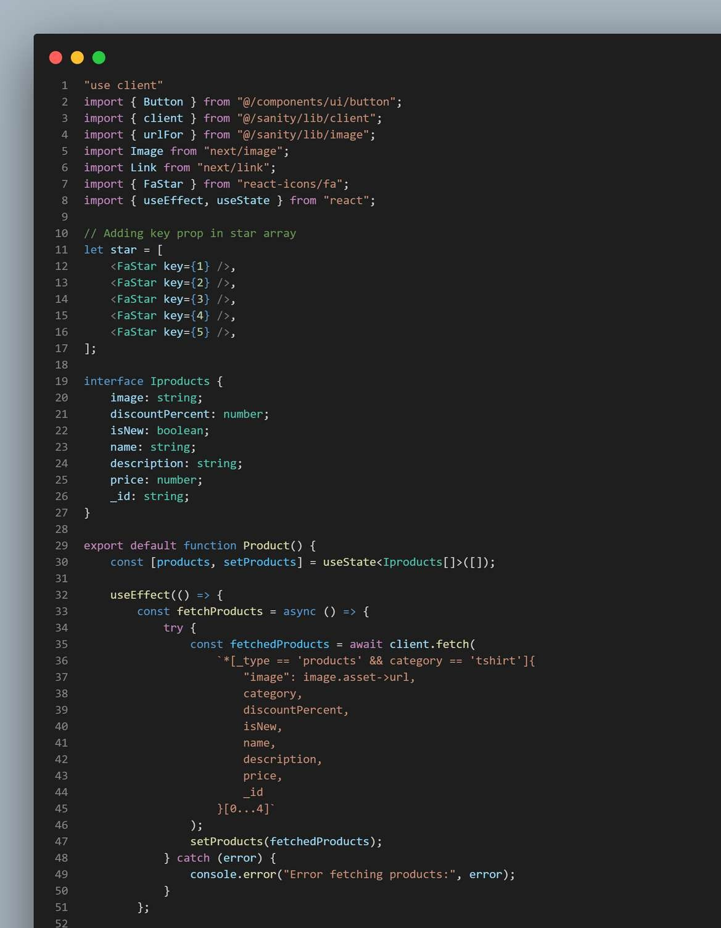
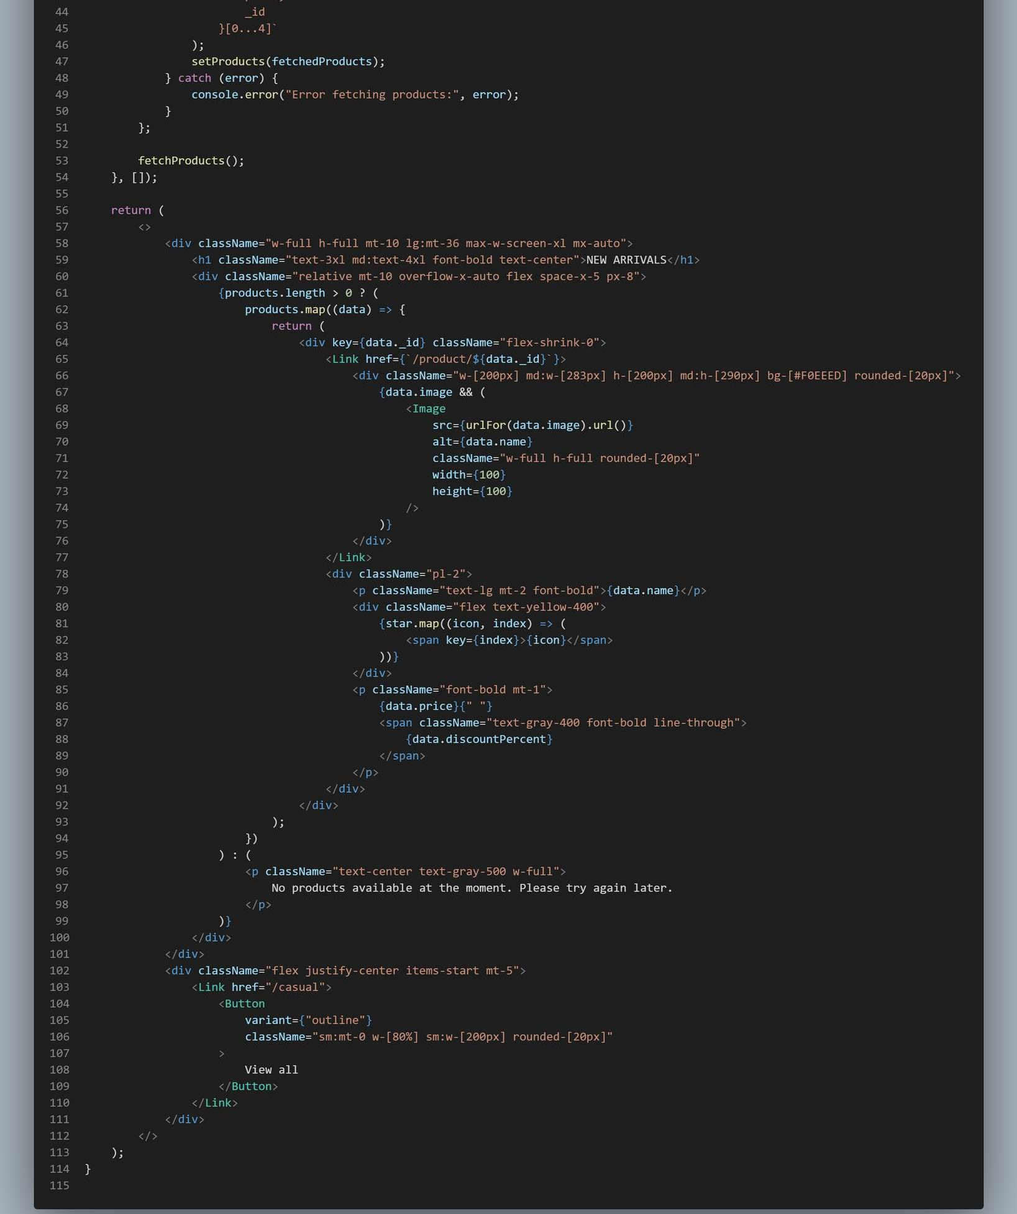
Product Listing Page

Slide 8
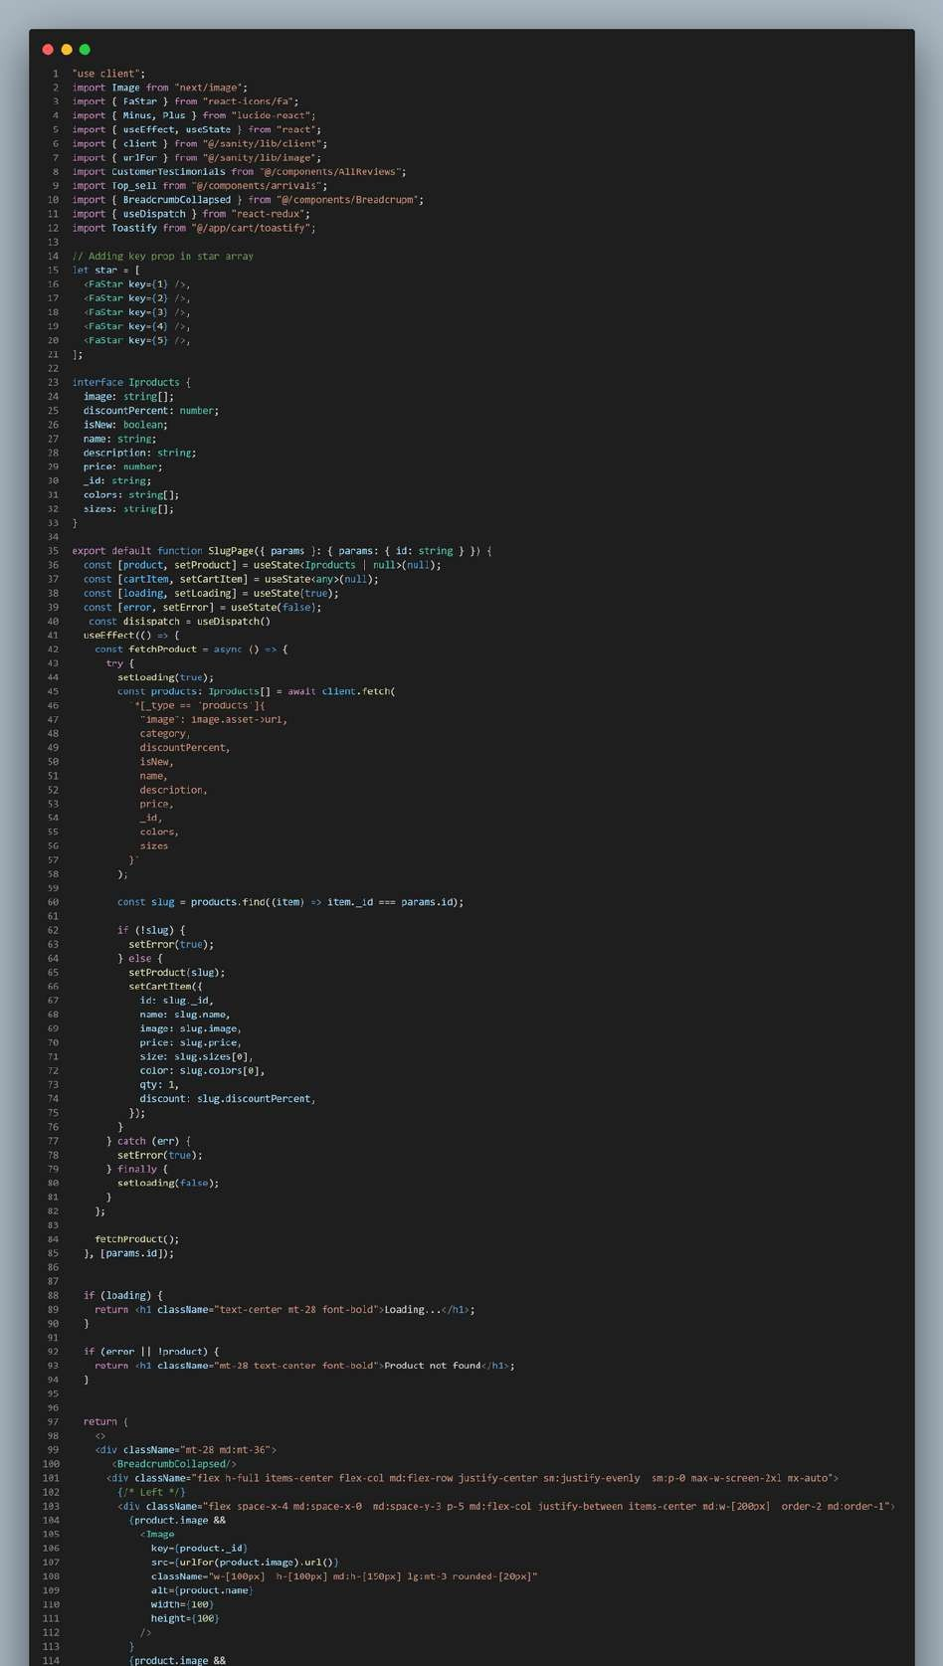
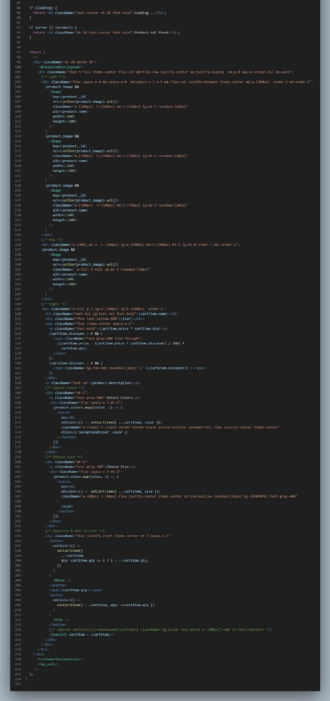
Product Detail Page
Dynamic Routing

Slide 9
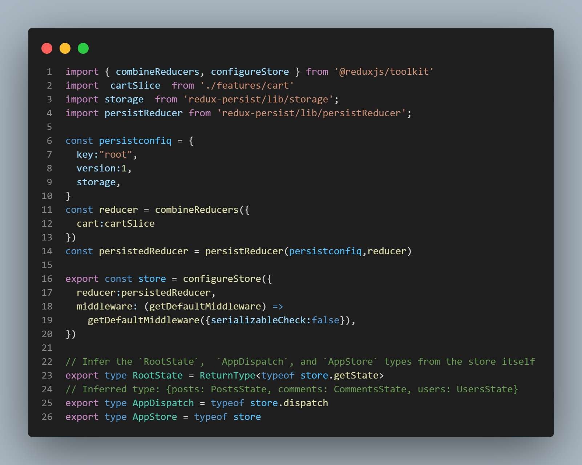
Redux Store

Slide 10
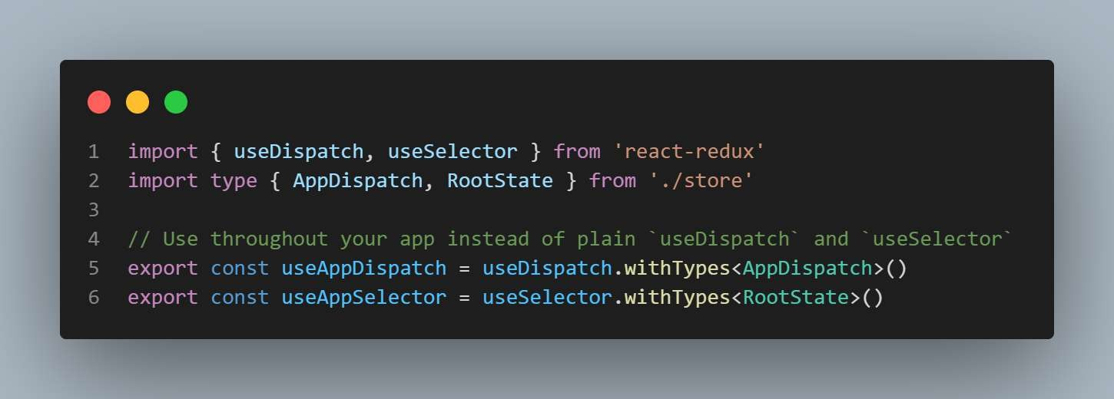
Hooks

Slide 11
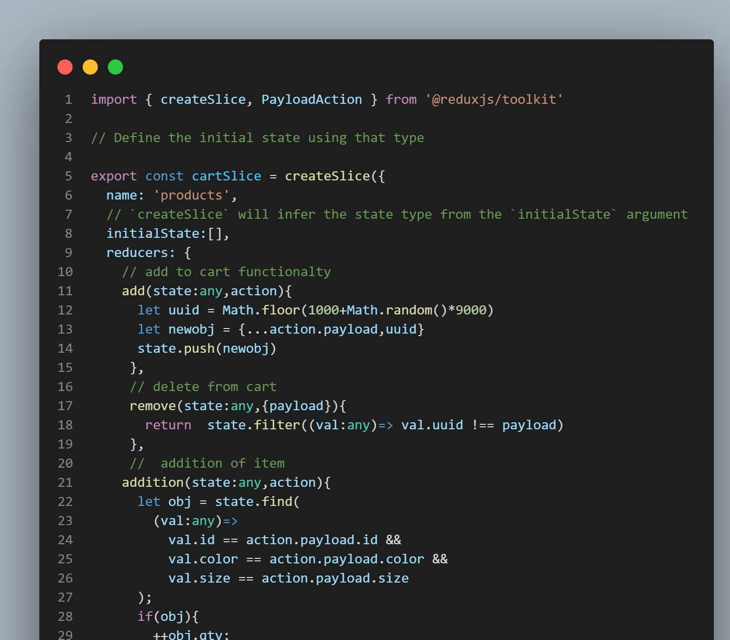
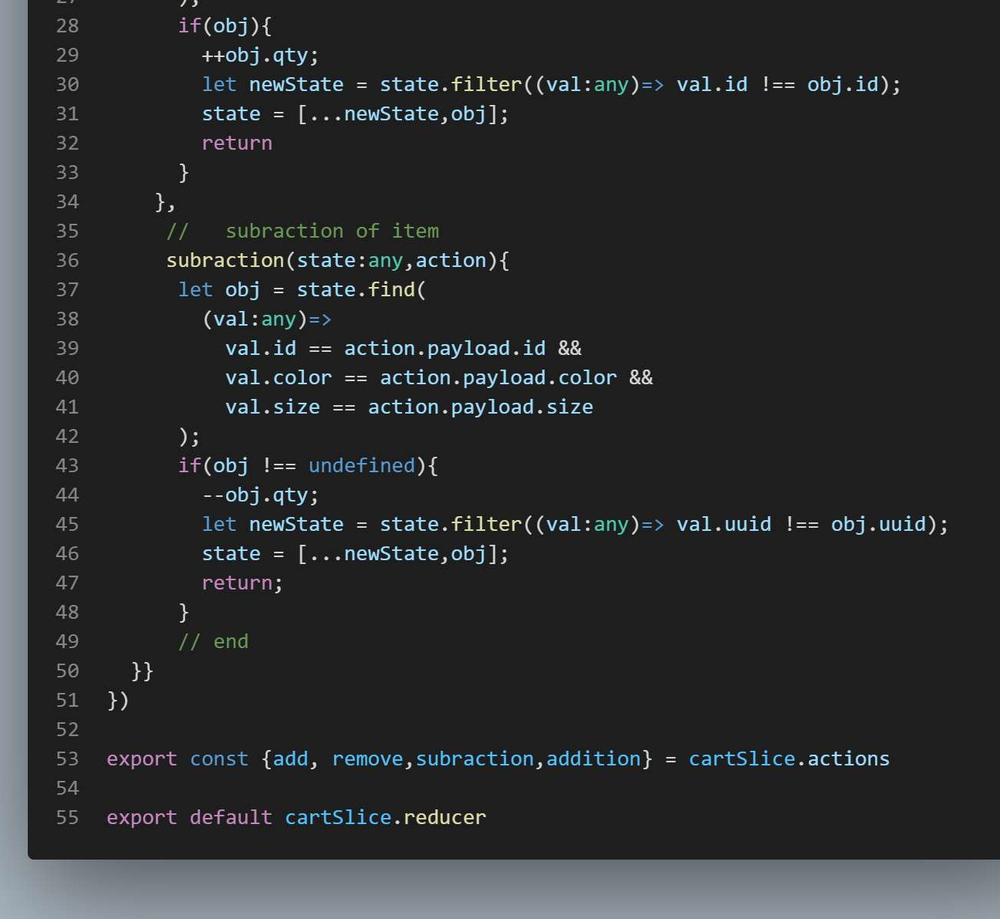
Cartslice

Slide 12
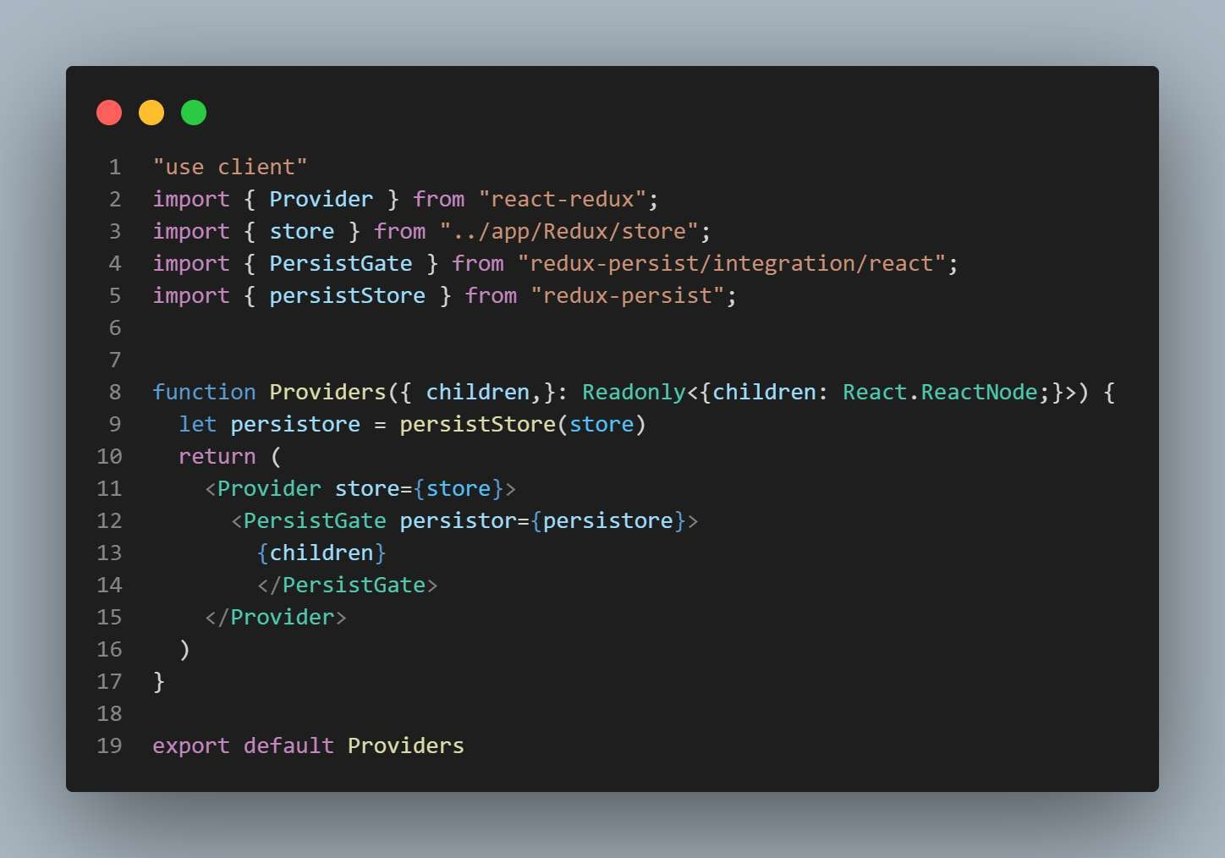
Provider

Slide 13
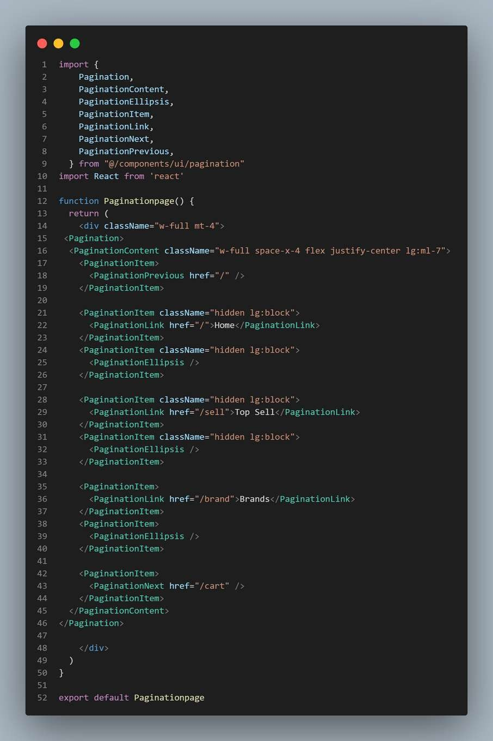
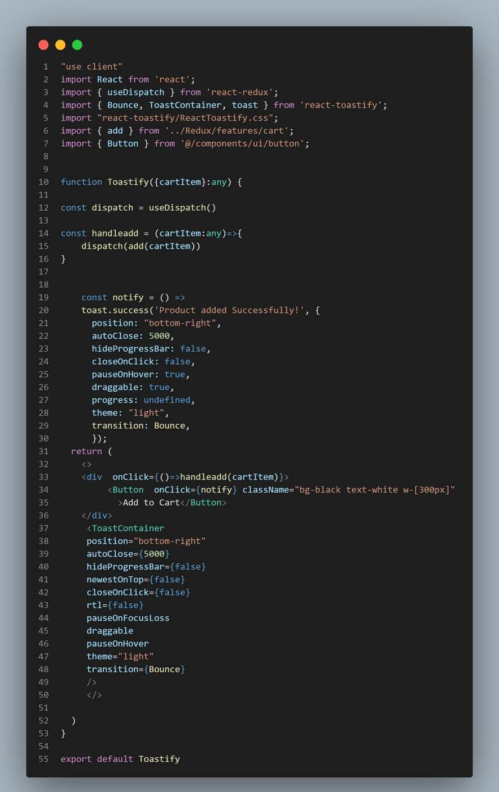
Pagination &
Toastify

Slide 14
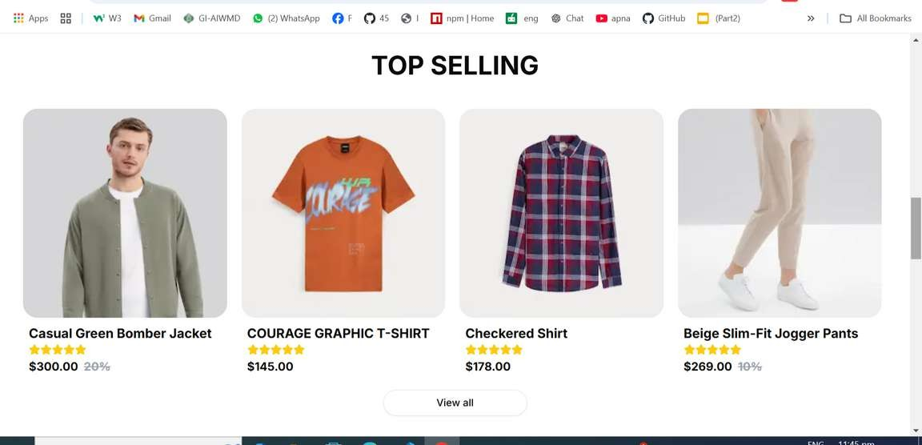
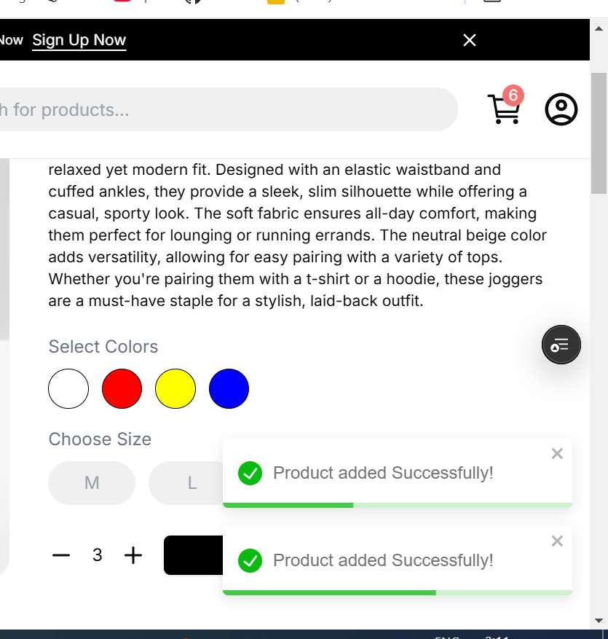
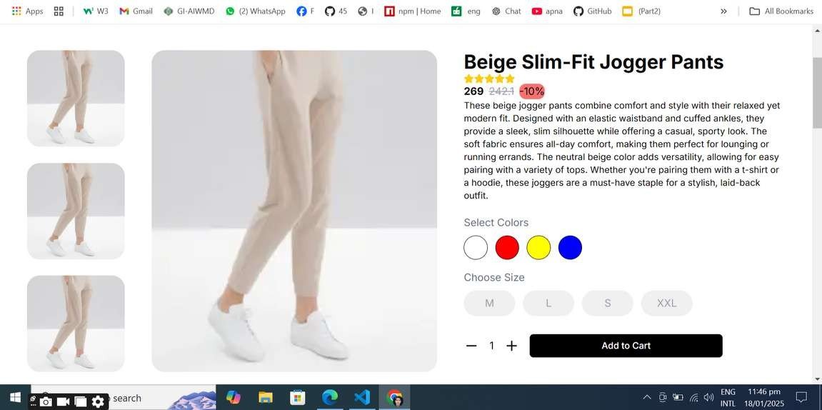
Product Listing
Toastify
Detail Page

Slide 15
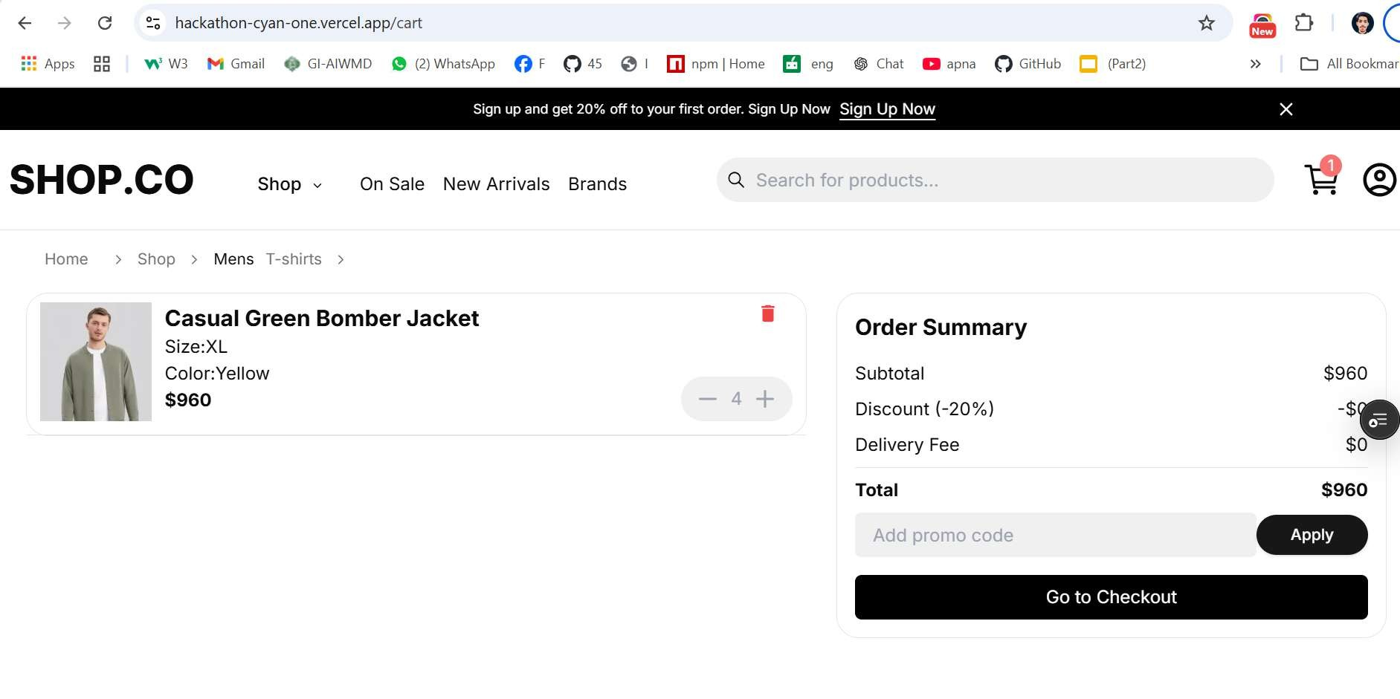
Cart Page

Slide 16




THANK YOU

